Slide 1

Manufacturer’s Rep
Vs
Manufacturers’ Rep

Slide 2
Issues with POS 11
Lack of definitive guidelines with retired LCD
  Medical Necessity
  Documentation
Diversity of conduct among manufacturers, reps
  Rebates vs ASP
  Federal Anti-kickback statute’s bright and dim lines
    Guarantees
    Excessive discounts
Financial risks to practice vs clinical benefits to patients
Volatility of CMS quarterly fee schedules, surveillance and adaptation
  JW & JZ
  Target issues with audit contractors

Slide 3
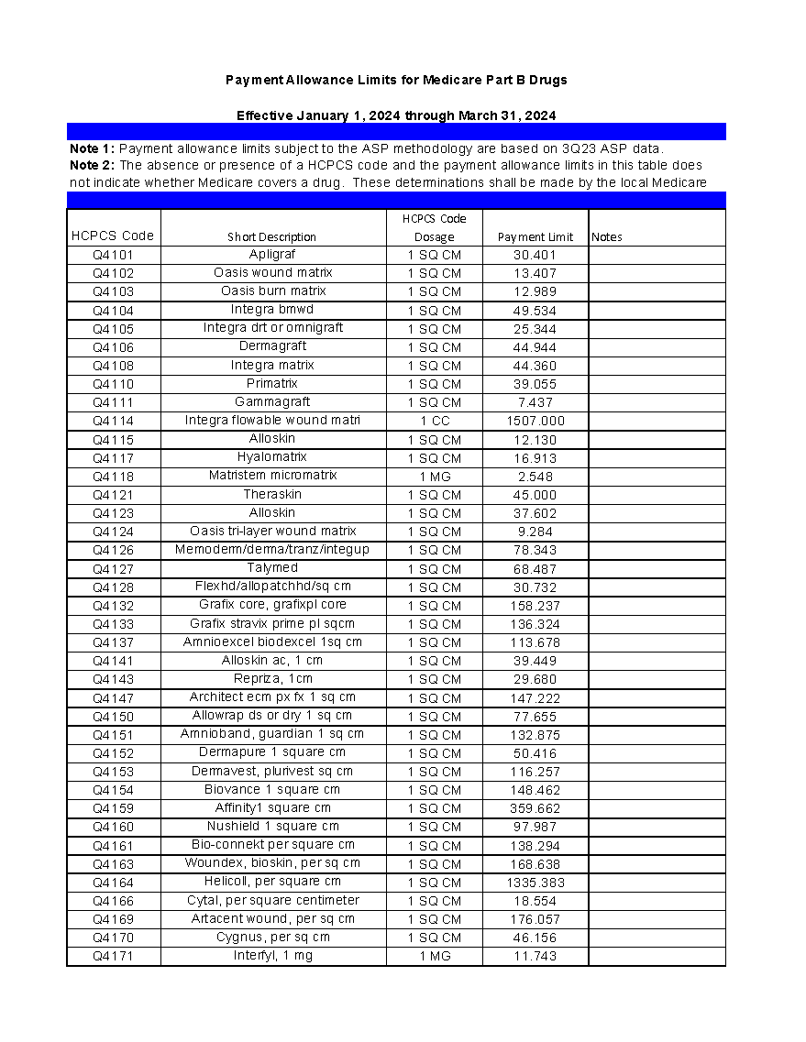
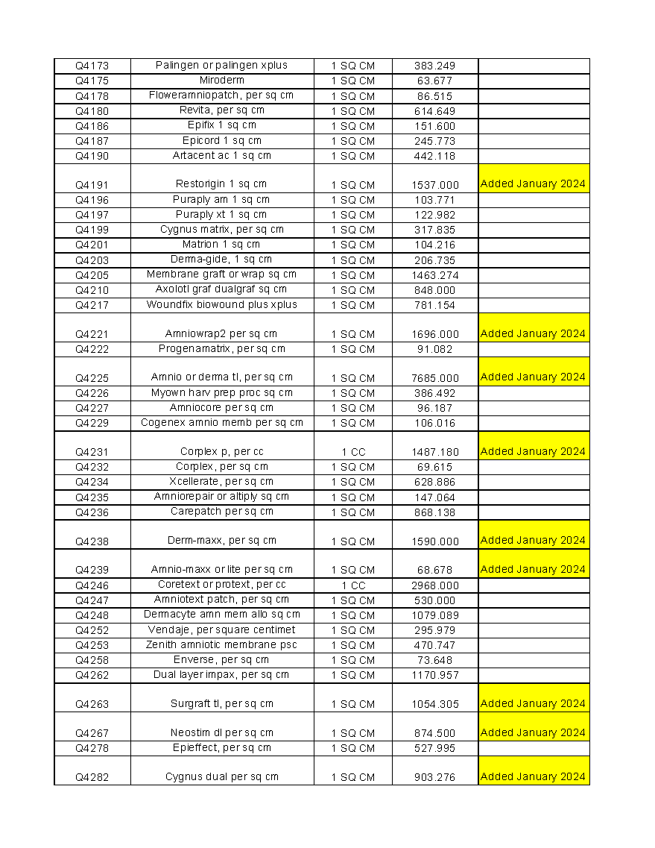

Slide 4
MUEs?

Slide 5
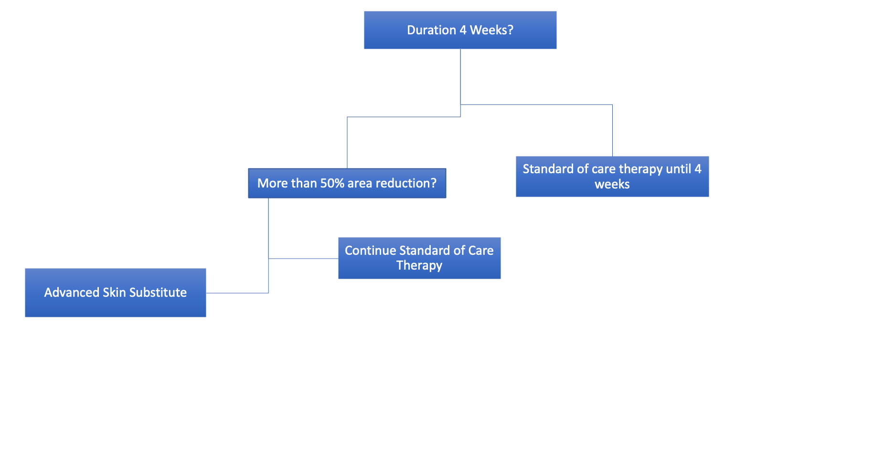
Q Code Flow Chart
NO
YES
YES
NO

Slide 6
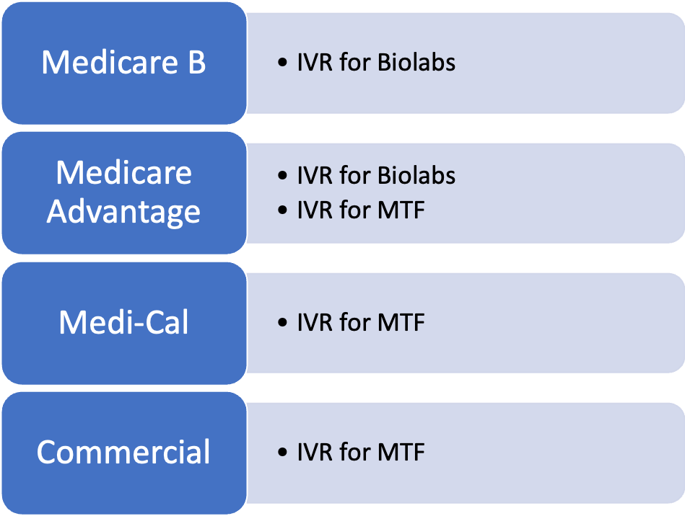
Skin Substitute Selector
Valid through March 31, 202

Slide 7
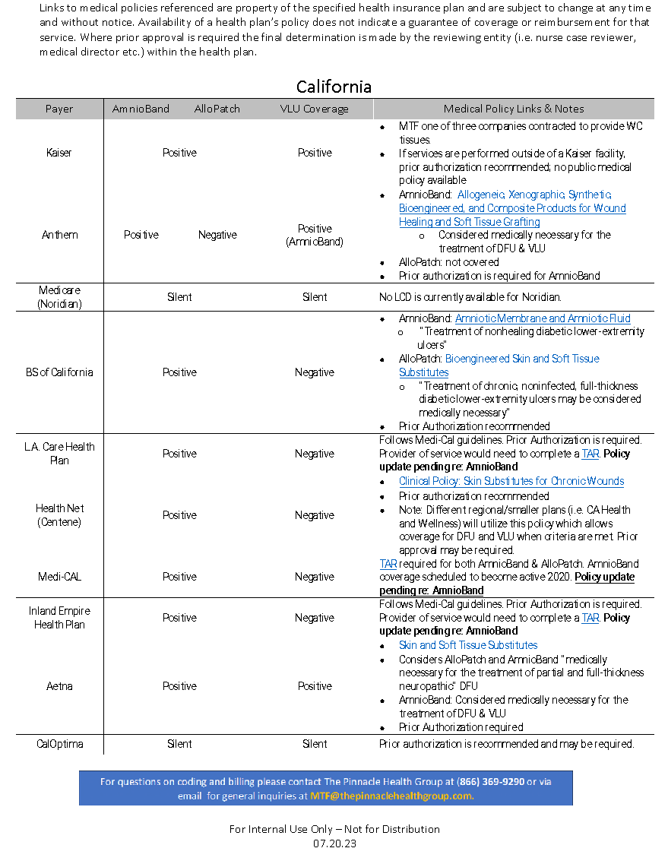

Slide 8
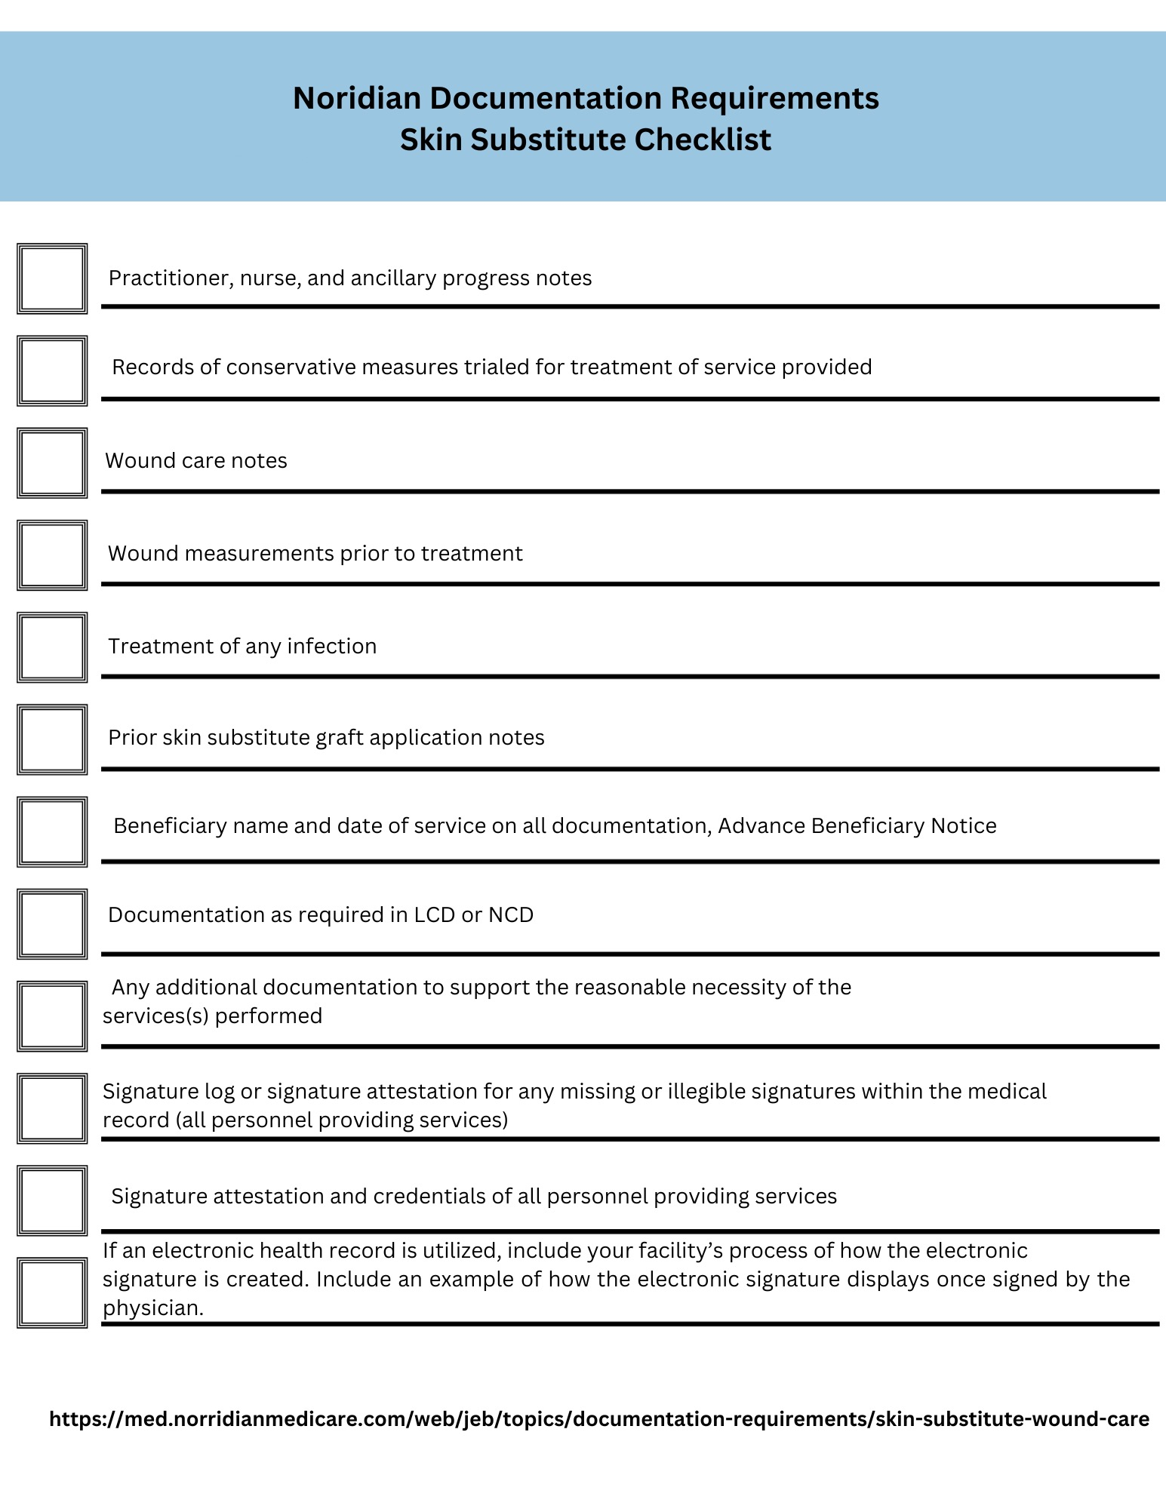

Slide 9
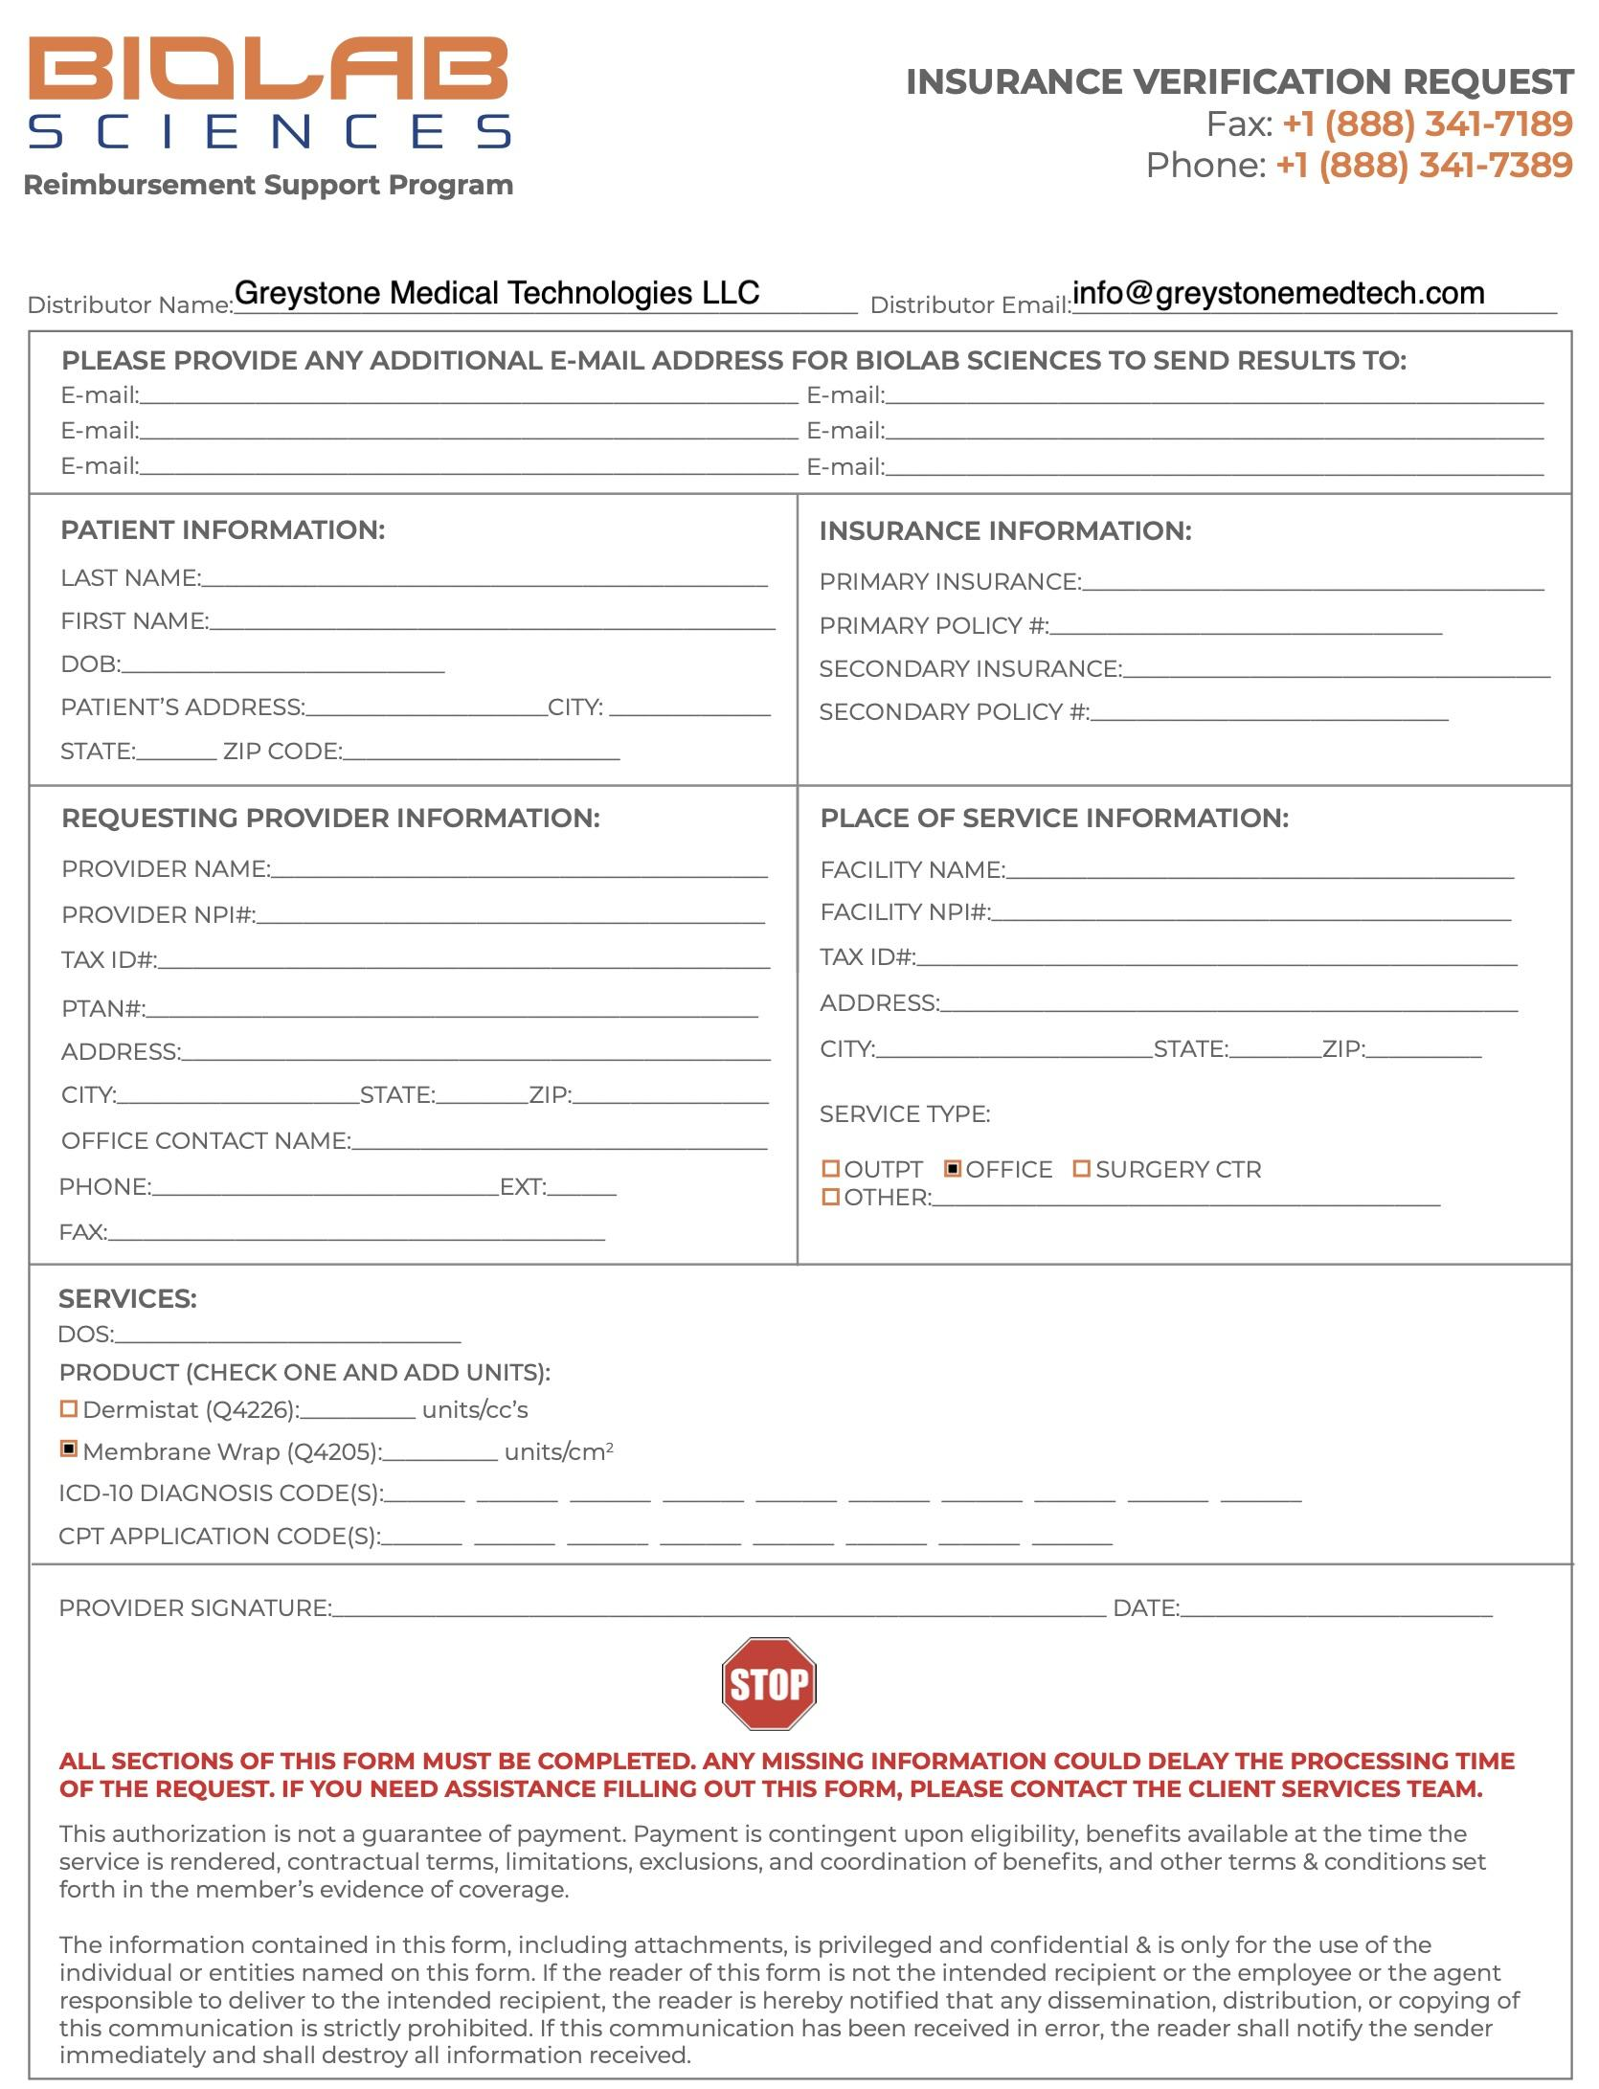

Slide 10
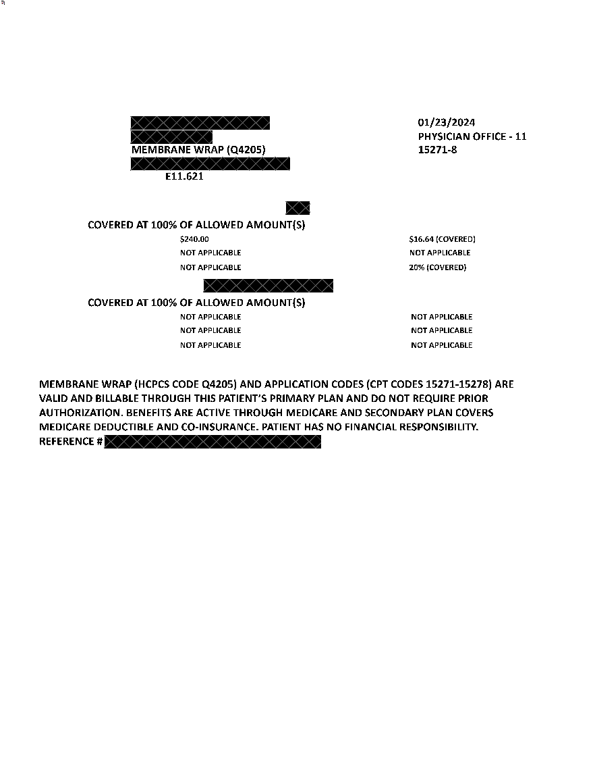
4Q23 Targeting and Product

Slide 11


Slide 12
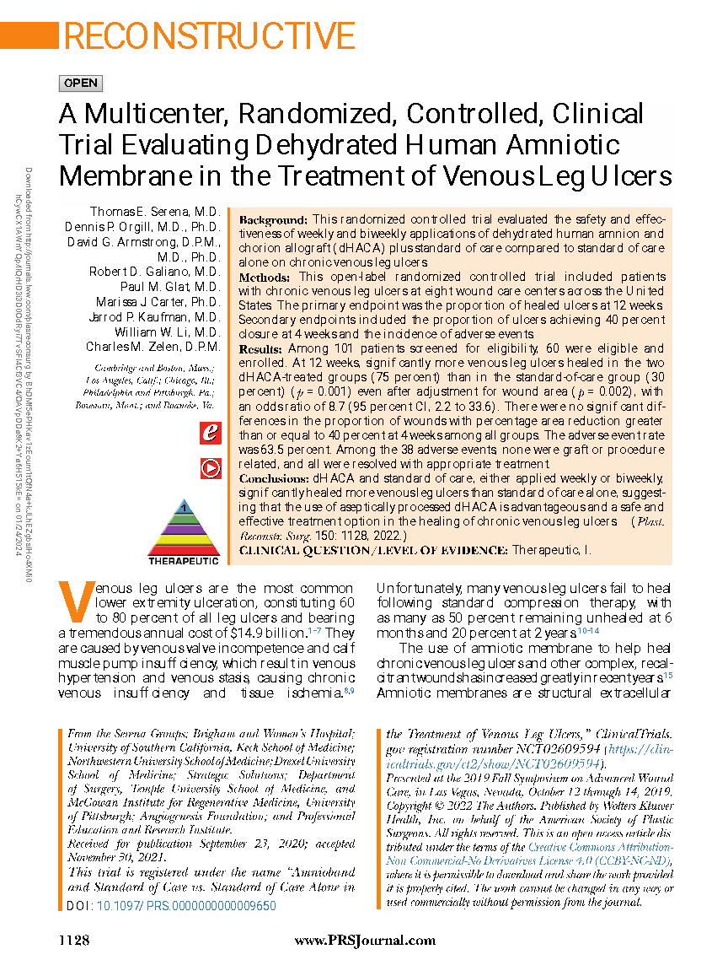
Appeals and Peer-to-Peer

